Slide 1
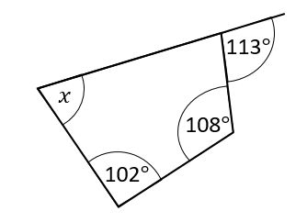
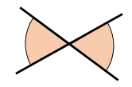
Y7 Summer | Week 7 | Day 1

Slide 2
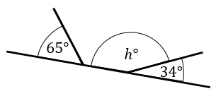
Y7 Summer | Week 7 | Day 2

Slide 3
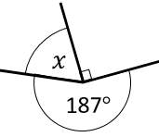
Y7 Summer | Week 7 | Day 3

Slide 4
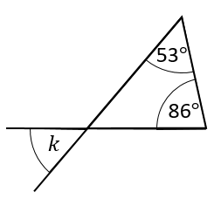
Y7 Summer | Week 7 | Day 4

Slide 5
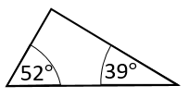
Y7 Summer | Week 7 | Day 5

Slide 6
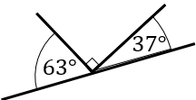
Y7 Summer | Week 8 | Day 1
B
A

Slide 7
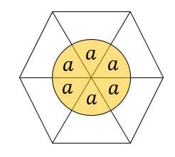
Y7 Summer | Week 8 | Day 2

Slide 8
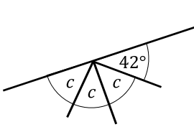
Y7 Summer | Week 8 | Day 3

Slide 9
Y7 Summer | Week 8 | Day 4

Slide 10
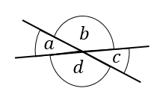
Y7 Summer | Week 8 | Day 5

